Slide 1

Guide to Computer Forensics and Investigations
Third Edition
Chapter 2
Understanding Computer Investigations

Slide 2
Objectives
Explain how to prepare a computer investigation
Apply a systematic approach to an investigation
Describe procedures for corporate high-tech investigations
Explain requirements for data recovery workstations and software
Describe how to conduct an investigation
Explain how to complete and critique a case
Guide to Computer Forensics and Investigations

Slide 3
Preparing a Computer Investigation
Evaluate the case
Follow an accepted procedure to prepare a case
Collect evidence
  Investigate the suspect’s computer
  Evidence should be bagged and tagged
  Preserve the evidence on a different computer
Document the chain of evidence, or chain of custody
Guide to Computer Forensics and Investigations

Slide 4
An Overview of a Computer Crime
Computers can be used to conduct crime:
  Events leading to a crime
Computers can store information related to crimes:
  Evidence that can lead to a conviction
Law enforcement officers should follow proper procedure when acquiring the evidence
  Digital evidence can be easily altered by an overeager investigator
Information on hard disks might be password protected
Guide to Computer Forensics and Investigations

Slide 5
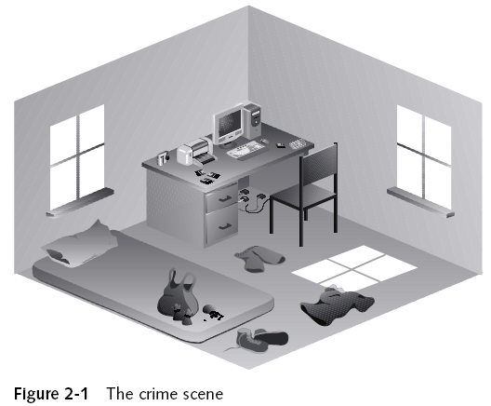
Examining a Computer Crime
Guide to Computer Forensics and Investigations

Slide 6
An Overview of a Company Policy Violation
Employees misusing resources can cost companies millions of dollars
Misuse includes:
  Surfing the Internet
  Sending personal e-mails
  Using company computers for personal tasks
Guide to Computer Forensics and Investigations

Slide 7
Taking a Systematic Approach
Steps for problem solving
  Make an initial assessment about the type of case you are investigating
  Determine a preliminary design or approach to the case
  Create a detailed checklist
  Determine the resources you need
  Obtain and copy an evidence disk drive
Guide to Computer Forensics and Investigations

Slide 8
Taking a Systematic Approach
(continued)
Steps for problem solving (continued)
  Identify the risks
  Mitigate or minimize the risks
  Test the design
  Analyze and recover the digital evidence
  Investigate the data you recover
  Complete the case report
  Critique the case
Guide to Computer Forensics and Investigations

Slide 9
Assessing the Case
Systematically outline the case details
  Situation
  Nature of the case
  Specifics of the case
  Type of evidence
  Operating system
  Known disk format
  Location of evidence
Guide to Computer Forensics and Investigations

Slide 10
Assessing the Case (continued)
Based on case details, you can determine the case requirements
  Computer forensics tools
  Special operating systems
Guide to Computer Forensics and Investigations

Slide 11
Planning Your Investigation
A basic investigation plan should include the following activities:
  Acquire the evidence
  Complete an evidence form and establish a chain of custody
  Transport the evidence to a computer forensics lab
  Secure evidence in an approved secure container
Guide to Computer Forensics and Investigations

Slide 12
Planning Your Investigation
(continued)
A basic investigation plan (continued):
  Prepare a forensics workstation
  Obtain the evidence from the secure container
  Make a forensic copy of the evidence
  Return the evidence to the secure container
  Process the copied evidence with computer forensics tools
Guide to Computer Forensics and Investigations

Slide 13
Planning Your Investigation
(continued)
An evidence custody form helps you document what has been done with the original evidence and its forensics copies
Two types
  Single-evidence form
    Lists each piece of evidence on a separate page
  Multi-evidence form
Guide to Computer Forensics and Investigations

Slide 14
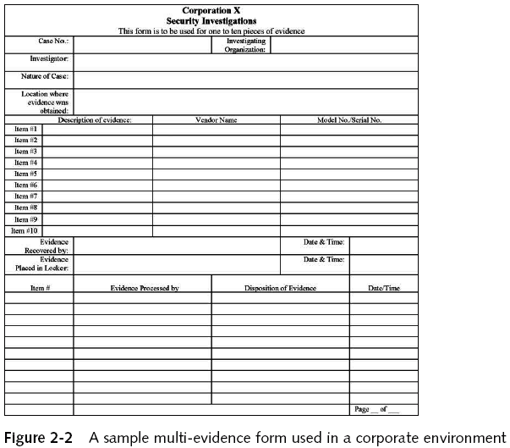
Planning Your Investigation
(continued)
Guide to Computer Forensics and Investigations

Slide 15
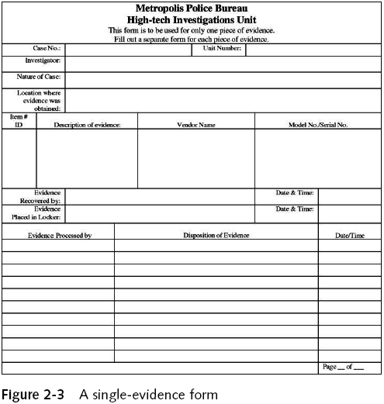
Planning Your Investigation
(continued)
Guide to Computer Forensics and Investigations

Slide 16
Securing Your Evidence
Use evidence bags to secure and catalog the evidence
Use computer safe products
  Antistatic bags
  Antistatic pads
Use well padded containers
Use evidence tape to seal all openings
  Floppy disk or CD drives
  Power supply electrical cord
Guide to Computer Forensics and Investigations

Slide 17
Securing Your Evidence (continued)
Write your initials on tape to prove that evidence has not been tampered with
Consider computer specific temperature and humidity ranges
Guide to Computer Forensics and Investigations

Slide 18
Procedures for Corporate High-Tech Investigations
Develop formal procedures and informal checklists
  To cover all issues important to high-tech investigations
  Procedures are necessary to ensure that correct techniques are used
  Checklists are necessary to ensure that all evidence is collected and processed properly.
  Sample procedures will be listed.
    Employee termination cases
    Attorney-client privilege investigation
    Media leak investigation
    Industrial espionage investigation
    Interviews and interrogations in high-tech investigations
Guide to Computer Forensics and Investigations

Slide 19
Employee Termination Cases
Majority of investigative work for termination cases involves employee abuse of corporate assets
Internet abuse investigations
  To conduct an investigation you need:
    Organization’s Internet proxy server logs
    Suspect computer’s IP address
    Suspect computer’s disk drive
    Your preferred computer forensics analysis tool
Guide to Computer Forensics and Investigations

Slide 20
Employee Termination Cases (continued)
Internet abuse investigations (continued)
  Recommended steps
    Use standard forensic analysis techniques and procedures
    Use appropriate tools to extract all Web page URL information
    Contact the network firewall administrator and request a proxy server log
    Compare the data recovered from forensic analysis to the proxy server log
    Continue analyzing the computer’s disk drive data
Guide to Computer Forensics and Investigations

Slide 21
Employee Termination Cases (continued)
E-mail abuse investigations
  To conduct an investigation you need:
    An electronic copy of the offending e-mail that contains message header data
    If available, e-mail server log records
    For e-mail systems that store users’ messages on a central server, access to the server
    Access to the computer so that you can perform a forensic analysis on it
    Your preferred computer forensics analysis tool
Guide to Computer Forensics and Investigations

Slide 22
Employee Termination Cases (continued)
E-mail abuse investigations (continued)
  Recommended steps
    Use the standard forensic analysis techniques
    Obtain an electronic copy of the suspect’s and victim’s e-mail folder or data
    For Web-based e-mail investigations, use tools such as FTK’s Internet Keyword Search option to extract all related e-mail address information
    Examine header data of all messages of interest to the investigation
Guide to Computer Forensics and Investigations

Slide 23
Attorney-Client Privilege Investigations
Under attorney-client privilege (ACP) rules for an attorney
  You must keep all findings confidential
Many attorneys like to have printouts of the data you have recovered
  You need to persuade and educate many attorneys on how digital evidence can be viewed electronically
You can also encounter problems if you find data in the form of binary files
Guide to Computer Forensics and Investigations

Slide 24
Attorney-Client Privilege Investigations (continued)
Steps for conducting an ACP case
  Request a memorandum from the attorney directing you to start the investigation
  Request a list of keywords of interest to the investigation
  Initiate the investigation and analysis
  For disk drive examinations, make two bit-stream images using different tools
  Compare hash signatures on all files on the original and re-created disks
Guide to Computer Forensics and Investigations

Slide 25
Attorney-Client Privilege Investigations (continued)
Steps for conducting an ACP case (continued)
  Methodically examine every portion of the disk drive and extract all data
  Run keyword searches on allocated and unallocated disk space
  For Windows OSs, use specialty tools to analyze and extract data from the Registry
  For binary data files such as CAD drawings, locate the correct software product
  For unallocated data recovery, use a tool that removes or replaces nonprintable data
  Consolidate all recovered data from the evidence bit-stream image into folders and subfolders
Guide to Computer Forensics and Investigations

Slide 26
Attorney-Client Privilege Investigations (continued)
Other guidelines
  Minimize written communications with the attorney
  Any documentation written to the attorney must contain a header stating that it’s “Privileged Legal Communication—Confidential Work Product”
Guide to Computer Forensics and Investigations

Slide 27
Attorney-Client Privilege Investigations (continued)
Other guidelines (continued)
  Assist attorney and paralegal in analyzing the data
If you have difficulty complying with the directions
  Contact the attorney and explain the problem
Always keep an open line of verbal communication
If you’re communicating via e-mail, use encryption
Guide to Computer Forensics and Investigations

Slide 28
Media Leak Investigations
In the corporate environment, controlling sensitive data can be difficult
Consider the following for media leak investigations
  Examine e-mail
  Examine Internet message boards
  Examine proxy server logs
  Examine known suspects’ workstations
  Examine all company telephone records
Guide to Computer Forensics and Investigations

Slide 29
Media Leak Investigations (consider)
Steps to take for media leaks
  Interview management privately
    To get a list of employees who have direct knowledge of the sensitive data
  Identify media source that published the information
  Review company phone records
  Obtain a list of keywords related to the media leak
  Perform keyword searches on proxy and e-mail servers
Guide to Computer Forensics and Investigations

Slide 30
Media Leak Investigations (consider)
Steps to take for media leaks (continued)
  Discreetly conduct forensic disk acquisitions and analysis
  From the forensic disk examinations, analyze all e-mail correspondence
    And trace any sensitive messages to other people
  Expand the discreet forensic disk acquisition and analysis
  Consolidate and review your findings periodically
  Routinely report findings to management
Guide to Computer Forensics and Investigations

Slide 31
Industrial Espionage Investigations
All suspected industrial espionage cases should be treated as criminal investigations
  International Traffic in Arms Regulations (ITAR)
  Export Administration Regulations (EAR)
Staff needed
  Computing investigator who is responsible for disk forensic examinations
  Technology specialist who is knowledgeable of the suspected compromised technical data
  Network specialist who can perform log analysis and set up network sniffers
  Threat assessment specialist (typically an attorney)
Guide to Computer Forensics and Investigations

Slide 32
Industrial Espionage Investigations (continued)
Guidelines
  Determine whether this investigation involves a possible industrial espionage incident
  Consult with corporate attorneys and upper management
  Determine what information is needed to substantiate the allegation
  Generate a list of keywords for disk forensics and sniffer monitoring
  List and collect resources for the investigation
  Determine goal and scope of the investigation
  Initiate investigation after approval from management
Guide to Computer Forensics and Investigations

Slide 33
Industrial Espionage Investigations (continued)
Planning considerations
  Examine all e-mail of suspected employees
  Search Internet newsgroups or message boards
  Initiate physical surveillance
  Examine facility physical access logs for sensitive areas
  Determine suspect location in relation to the vulnerable asset
  Study the suspect’s work habits
  Collect all incoming and outgoing phone logs
Guide to Computer Forensics and Investigations

Slide 34
Industrial Espionage Investigations (continued)
Steps
  Gather all personnel assigned to the investigation and brief them on the plan
  Gather resources to conduct the investigation
  Place surveillance systems
  Discreetly gather any additional evidence
  Collect all log data from networks and e-mail servers
  Report regularly to management and corporate attorneys
  Review the investigation’s scope with management and corporate attorneys
Guide to Computer Forensics and Investigations

Slide 35
Interviews and Interrogations in High-Tech Investigations
Becoming a skilled interviewer and interrogator can take many years of experience
Interview
  Usually conducted to collect information from a witness or suspect
    About specific facts related to an investigation
Interrogation
  Trying to get a suspect to confess
Guide to Computer Forensics and Investigations

Slide 36
Interviews and Interrogations in High-Tech Investigations (continued)
Role as a computing investigator
  To instruct the investigator conducting the interview on what questions to ask
    And what the answers should be
Ingredients for a successful interview or interrogation
  Being patient throughout the session
  Repeating or rephrasing questions to zero in on specific facts from a reluctant witness or suspect
  Being tenacious
Guide to Computer Forensics and Investigations

Slide 37
Understanding Data Recovery Workstations and Software
Investigations are conducted on a computer forensics lab (or data-recovery lab)
Computer forensics and data-recovery are related but different
Computer forensics workstation
  Specially configured personal computer
  Loaded with additional bays and forensics software
To avoid altering the evidence use:
  Forensics boot floppy disk
  Write-blockers devices
Guide to Computer Forensics and Investigations

Slide 38
Setting Up your Computer for Computer Forensics
Basic requirements
  A workstation running Windows XP or Vista
  A write-blocker device
  Computer forensics acquisition tool
  Computer forensics analysis tool
  Target drive to receive the source or suspect disk data
  Spare PATA or SATA ports
  USB ports
Guide to Computer Forensics and Investigations

Slide 39
Setting Up your Computer for Computer Forensics (continued)
Additional useful items
  Network interface card (NIC)
  Extra USB ports
  FireWire 400/800 ports
  SCSI card
  Disk editor tool
  Text editor tool
  Graphics viewer program
  Other specialized viewing tools
Guide to Computer Forensics and Investigations

Slide 40
Conducting an Investigation
Gather resources identified in investigation plan
Items needed
  Original storage media
  Evidence custody form
  Evidence container for the storage media
  Bit-stream imaging tool
  Forensic workstation to copy and examine your evidence
  Securable evidence locker, cabinet, or safe
Guide to Computer Forensics and Investigations

Slide 41
Gathering the Evidence
Avoid damaging the evidence
Steps
  Meet the IT manager to interview him
  Fill out the evidence form, have the IT manager sign
  Place the evidence in a secure container
  Complete the evidence custody form
  Carry the evidence to the computer forensics lab
  Create forensics copies (if possible)
  Secure evidence by locking the container
Guide to Computer Forensics and Investigations

Slide 42
Understanding Bit-Stream Copies
Bit-stream copy
  Bit-by-bit copy of the original storage medium
  Exact copy of the original disk
  Different from a simple backup copy
    Backup software only copy known files
    Backup software cannot copy deleted files, e-mail messages or recover file fragments
Bit-stream image
  File containing the bit-stream copy of all data on a disk or partition
  Also known as forensic copy
Guide to Computer Forensics and Investigations

Slide 43
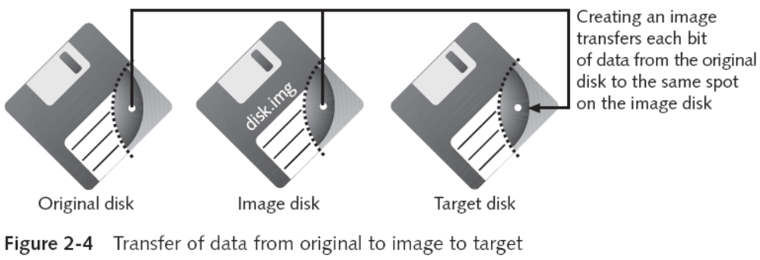
Understanding Bit-stream Copies (continued)
Copy image file to a target disk that matches the original disk’s manufacturer, size and model
Guide to Computer Forensics and Investigations

Slide 44
Acquiring an Image of Evidence Media
First rule of computer forensics
  Preserve the original evidence
Conduct your analysis only on a copy of the data
Using ProDiscover Basic to acquire a thumb drive
  Create a work folder for data storage
Guide to Computer Forensics and Investigations

Slide 45
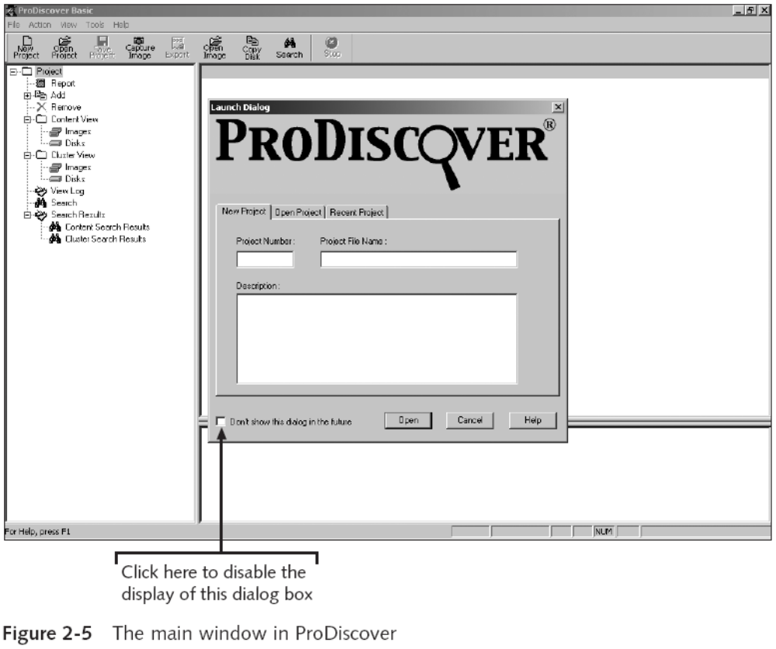
Acquiring an Image of Evidence Media (continued)
Guide to Computer Forensics and Investigations

Slide 46
Acquiring an Image of Evidence Media (continued)
Using ProDiscover Basic to acquire a thumb drive (continued)
  Steps
    On the thumb drive locate the write-protect switch and place the drive in write-protect mode
    Start ProDiscover Basic
    In the main window, click Action, Capture Image from the menu
    Click the Source Drive drop-down list, and select the thumb drive
    Click the >> button next to the Destination text box
    Type your name in the Technician Name text box
    ProDiscover Basic then acquires an image of the USB thumb drive
    Click OK in the completion message box
Guide to Computer Forensics and Investigations

Slide 47
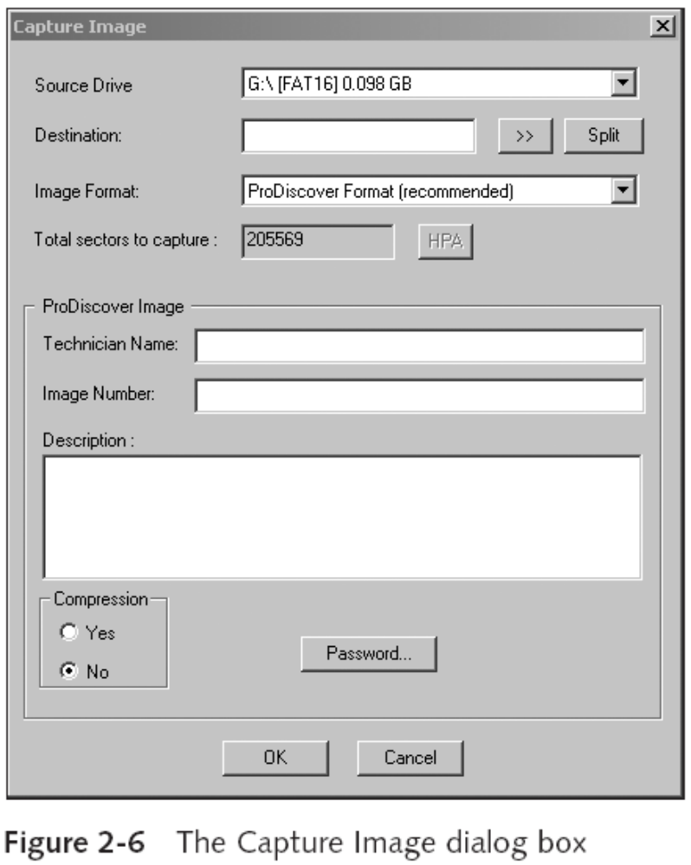
Acquiring an Image of Evidence Media (continued)
Guide to Computer Forensics and Investigations

Slide 48
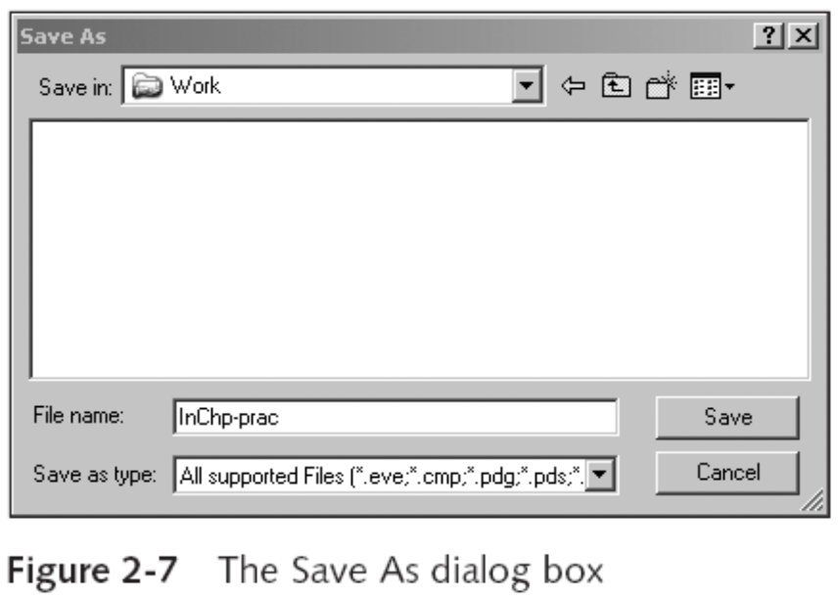
Acquiring an Image of Evidence Media (continued)
Guide to Computer Forensics and Investigations

Slide 49
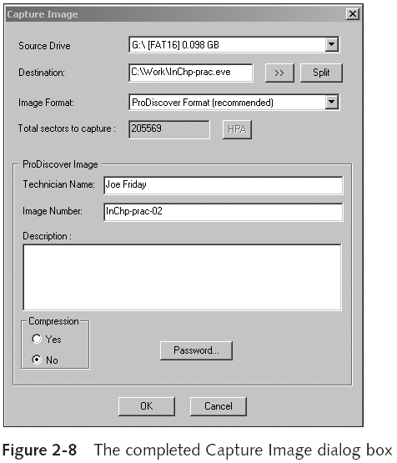
Acquiring an Image of Evidence Media (continued)
Guide to Computer Forensics and Investigations

Slide 50
Analyzing Your Digital Evidence
Your job is to recover data from:
  Deleted files
  File fragments
  Complete files
Deleted files linger on the disk until new data is saved on the same physical location
Tool
  ProDiscover Basic
Guide to Computer Forensics and Investigations

Slide 51
Analyzing Your Digital Evidence (continued)
Steps
  Start ProDiscover Basic
  Create a new case
  Type the project number
  Add an Image File
Steps to display the contents of the acquired data
  Click to expand Content View
  Click All Files under the image filename path
Guide to Computer Forensics and Investigations

Slide 52
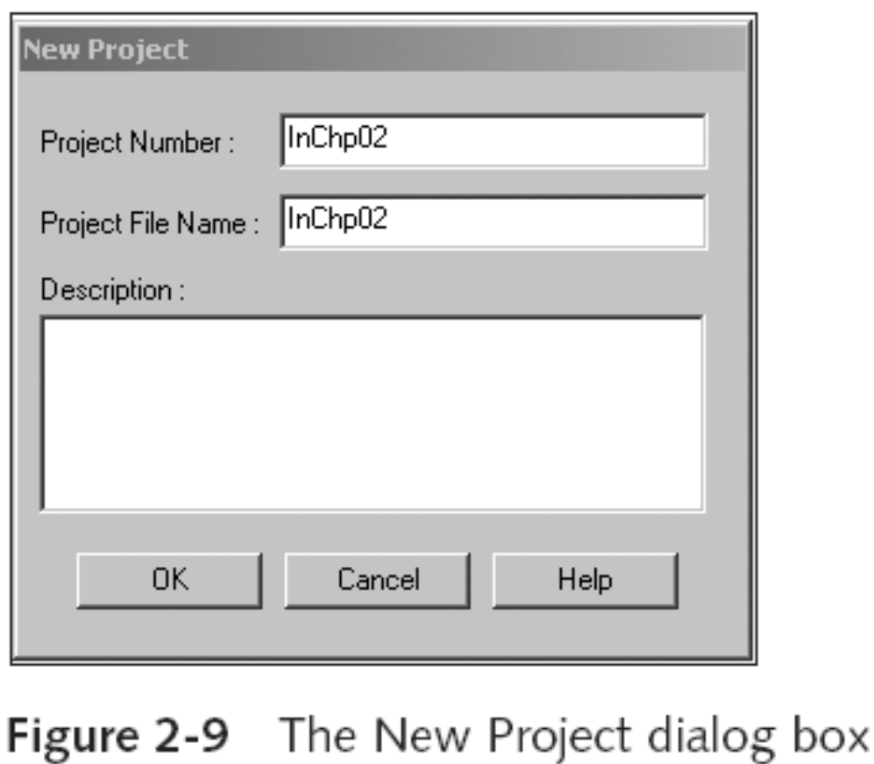
Analyzing Your Digital Evidence (continued)
Guide to Computer Forensics and Investigations

Slide 53
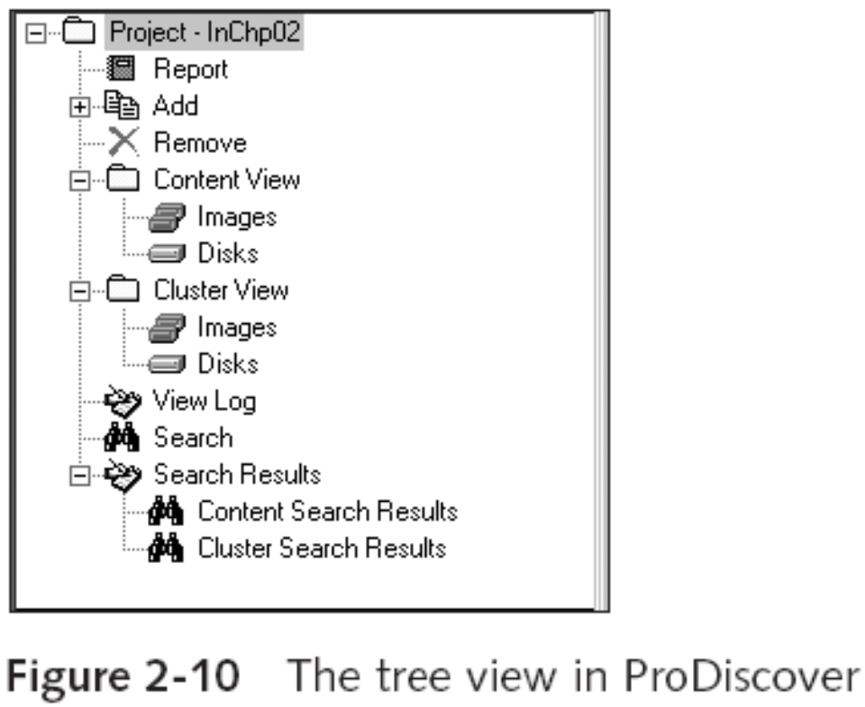
Analyzing Your Digital Evidence (continued)
Guide to Computer Forensics and Investigations

Slide 54
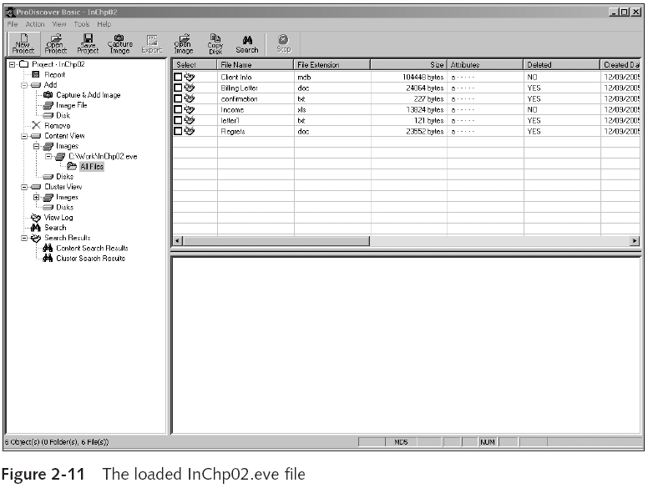
Analyzing Your Digital Evidence (continued)
Guide to Computer Forensics and Investigations

Slide 55
Analyzing Your Digital Evidence (continued)
Steps to display the contents of the acquired data (continued)
  Click letter1 to view its contents in the data area
  In the data area, view contents of letter1
Analyze the data
  Search for information related to the complaint
Data analysis can be most time-consuming task
Guide to Computer Forensics and Investigations

Slide 56
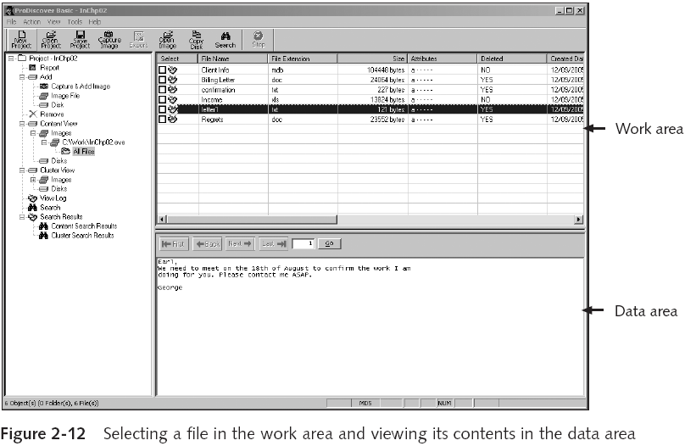
Analyzing Your Digital Evidence (continued)
Guide to Computer Forensics and Investigations

Slide 57
Analyzing Your Digital Evidence (continued)
With ProDiscover Basic you can:
  Search for keywords of interest in the case
  Display the results in a search results window
  Click each file in the search results window and examine its content in the data area
  Export the data to a folder of your choice
  Search for specific filenames
  Generate a report of your activities
Guide to Computer Forensics and Investigations

Slide 58
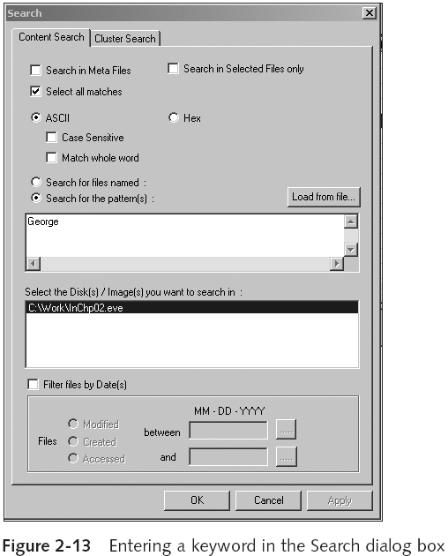
Analyzing Your Digital Evidence (continued)
Guide to Computer Forensics and Investigations

Slide 59
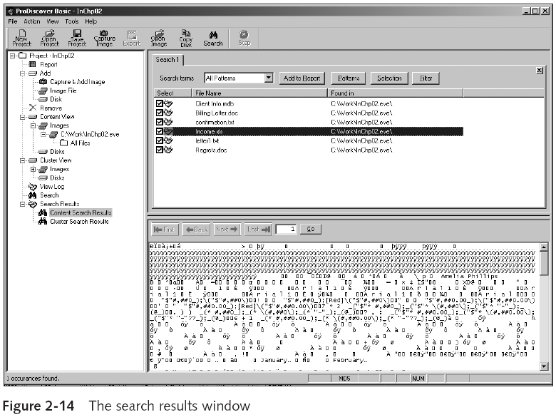
Analyzing Your Digital Evidence (continued)
Guide to Computer Forensics and Investigations

Slide 60
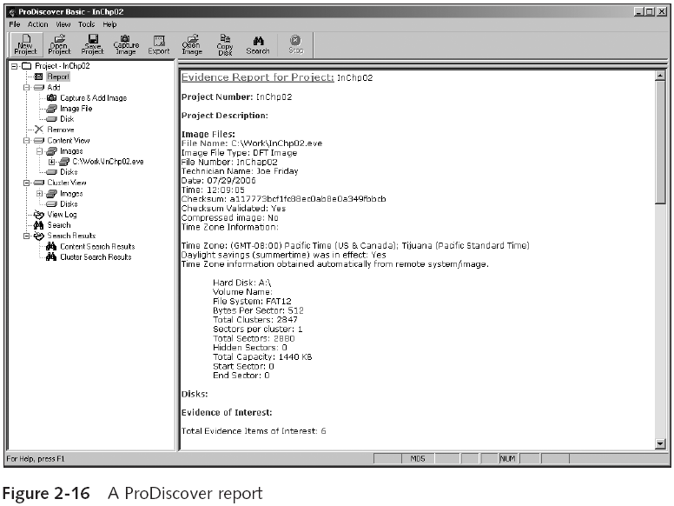
Analyzing Your Digital Evidence (continued)
Guide to Computer Forensics and Investigations

Slide 61
Completing the Case
You need to produce a final report
  State what you did and what you found
Include ProDiscover report to document your work
Repeatable findings
  Repeat the steps and produce the same result
If required, use a report template
Report should show conclusive evidence
  Suspect did or did not commit a crime or violate a company policy
Guide to Computer Forensics and Investigations

Slide 62
Critiquing the Case
Ask yourself the following questions:
  How could you improve your performance in the case?
  Did you expect the results you found? Did the case develop in ways you did not expect?
  Was the documentation as thorough as it could have been?
  What feedback has been received from the requesting source?
Guide to Computer Forensics and Investigations

Slide 63
Critiquing the Case (continued)
Ask yourself the following questions (continued):
  Did you discover any new problems? If so, what are they?
  Did you use new techniques during the case or during research?
Guide to Computer Forensics and Investigations

Slide 64
Summary
Always use a systematic approach to your investigations
Always plan a case taking into account the nature of the case, case requirements, and gathering evidence techniques
Both criminal cases and corporate-policy violations can go to court
Plan for contingencies for any problems you might encounter
Keep track of the chain of custody of your evidence
Guide to Computer Forensics and Investigations

Slide 65
Summary (continued)
Internet and media leak investigations require examining server log data
For attorney-client privilege cases, all written communication should remain confidential
A bit-stream copy is a bit-by-bit duplicate of the original disk
Always maintain a journal to keep notes on exactly what you did
You should always critique your own work
Guide to Computer Forensics and Investigations

